Slide 1
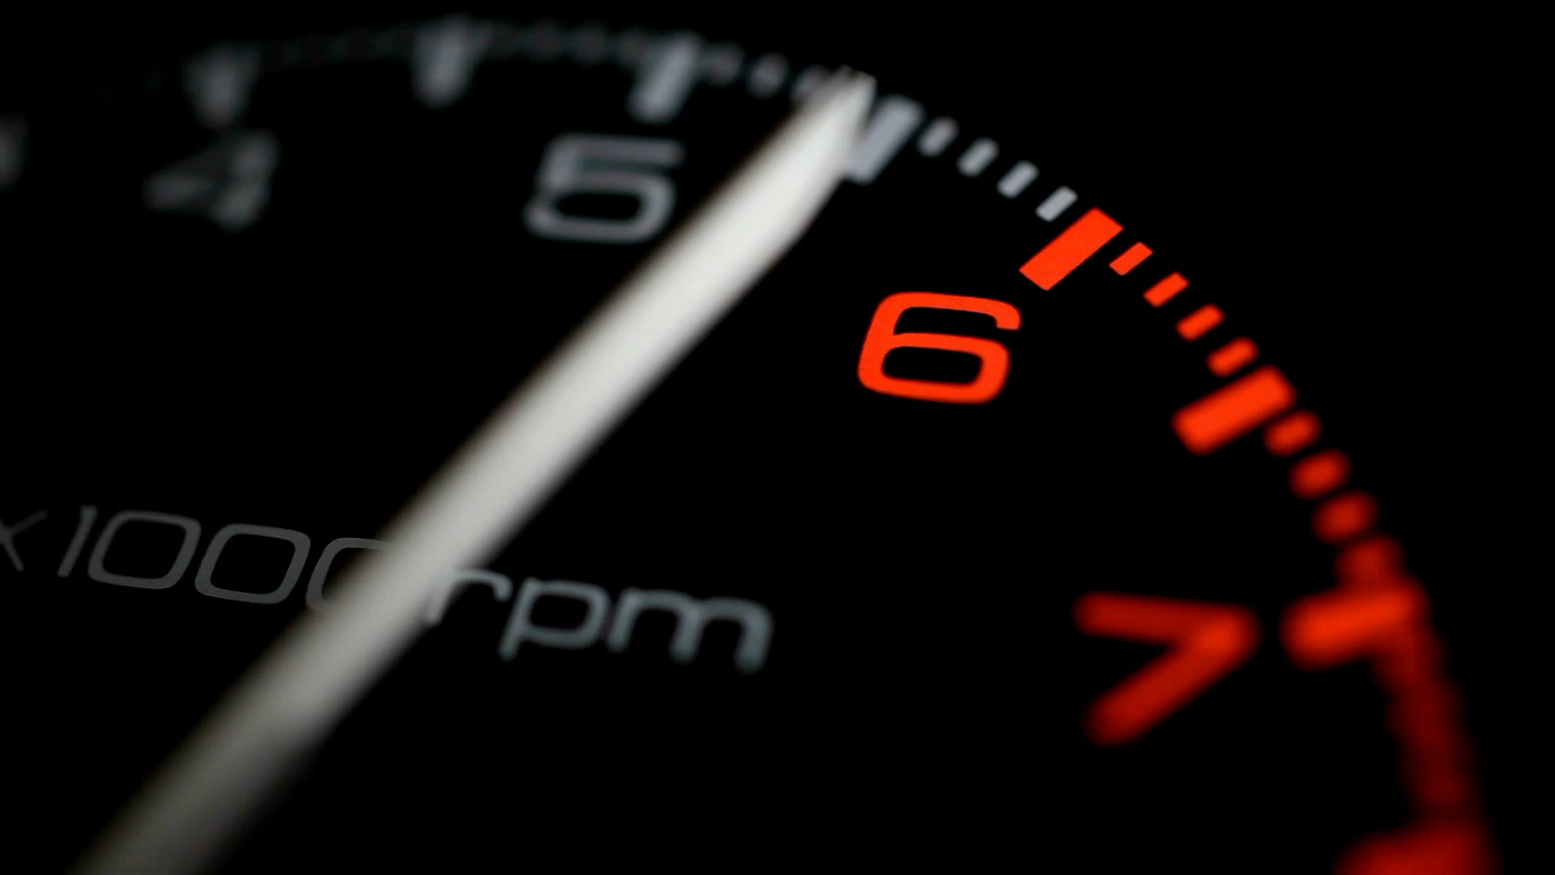
Tracking Position Velocity and Acceleration

Slide 2

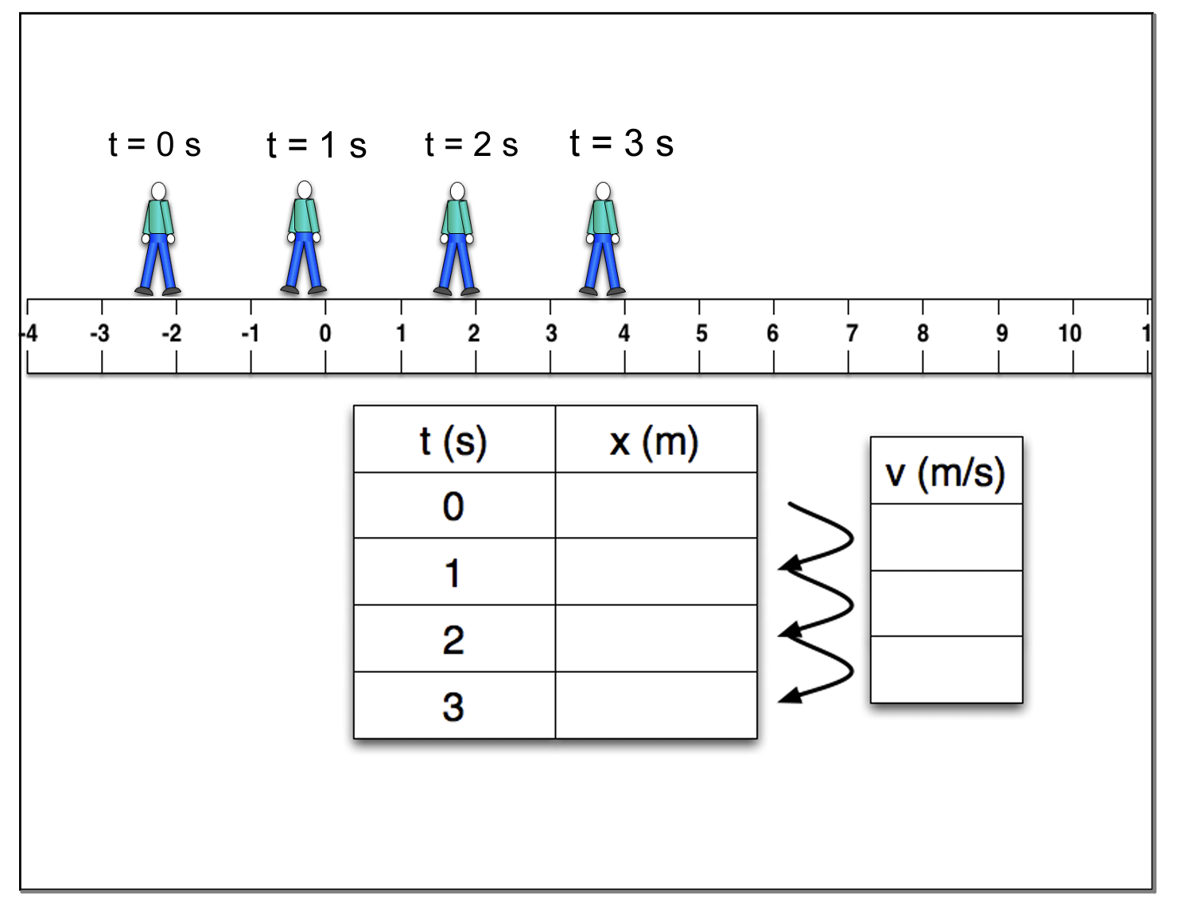
Track the FRONT of their foot!

Slide 3
Track the FRONT of their foot!
-2 m
+2 m/s
0 m
a = 0
+2 m/s
2 m
+2 m/s
4 m

Slide 4
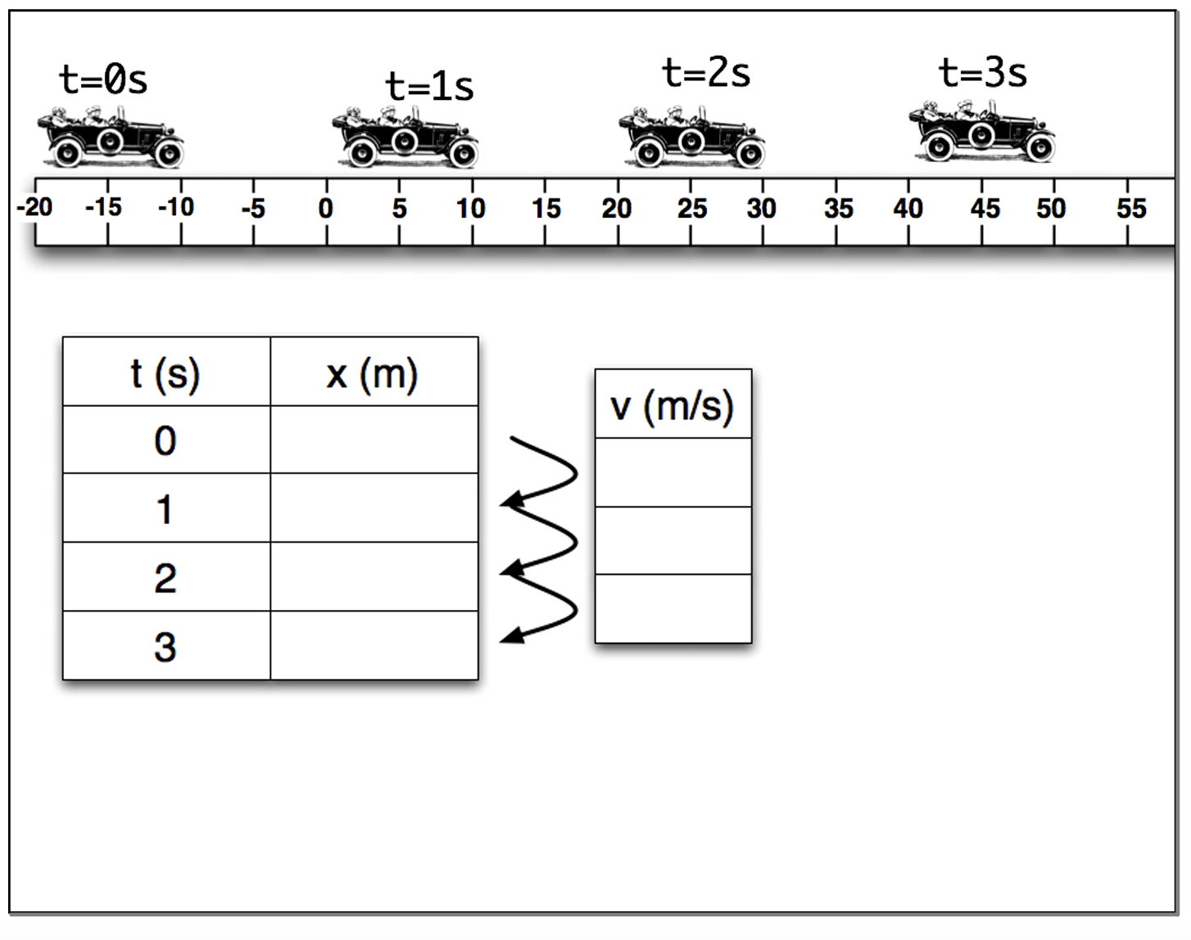
Track the FRONT of the Car!

Slide 5
-10 m
+20 m/s
10 m
a = 0
+20 m/s
30 m
+20 m/s
50 m
Track the FRONT of the Car!

Slide 6
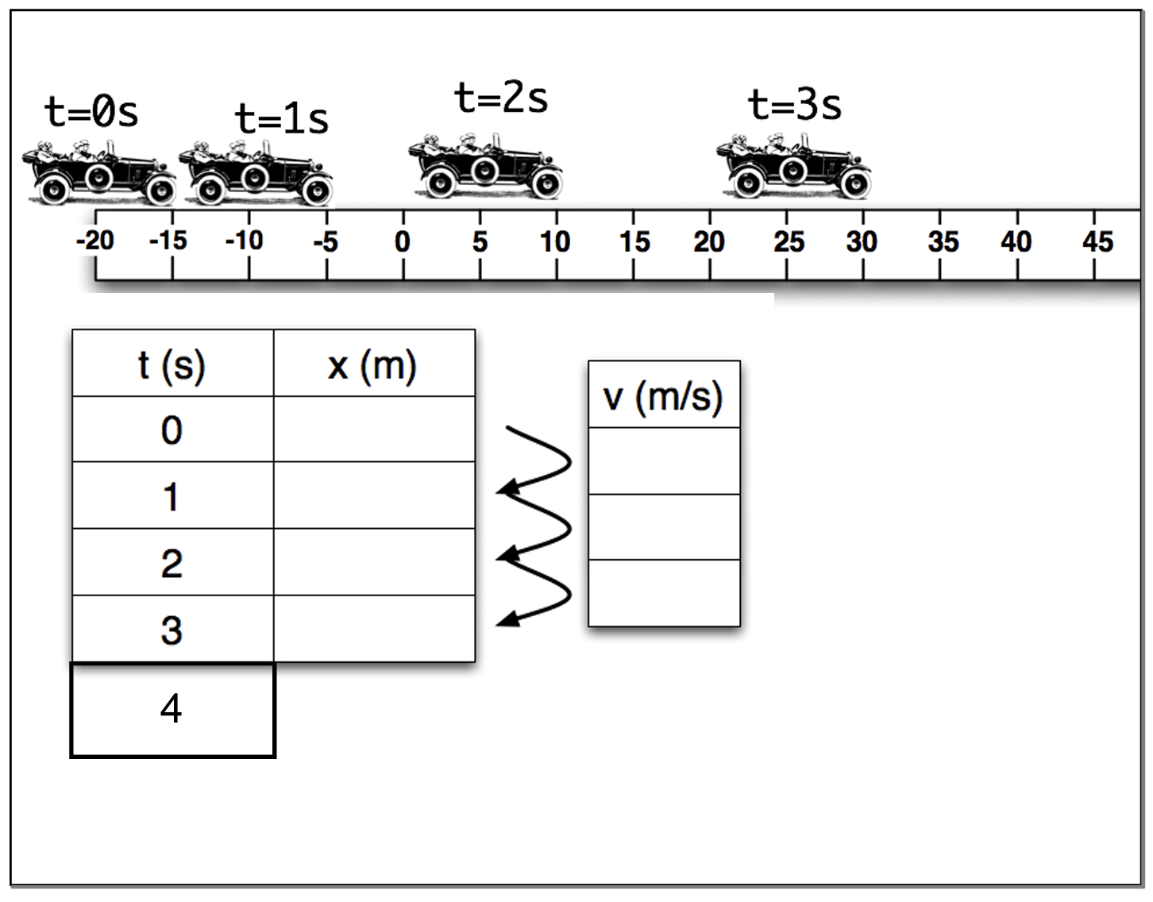
Track the FRONT of the Car!

Slide 7
-15 m
+10 m/s
-5 m
a = +5 m/s/s
+15 m/s
10 m
+20 m/s
30 m
+25 m/s
55 m
Track the FRONT of the Car!

Slide 8
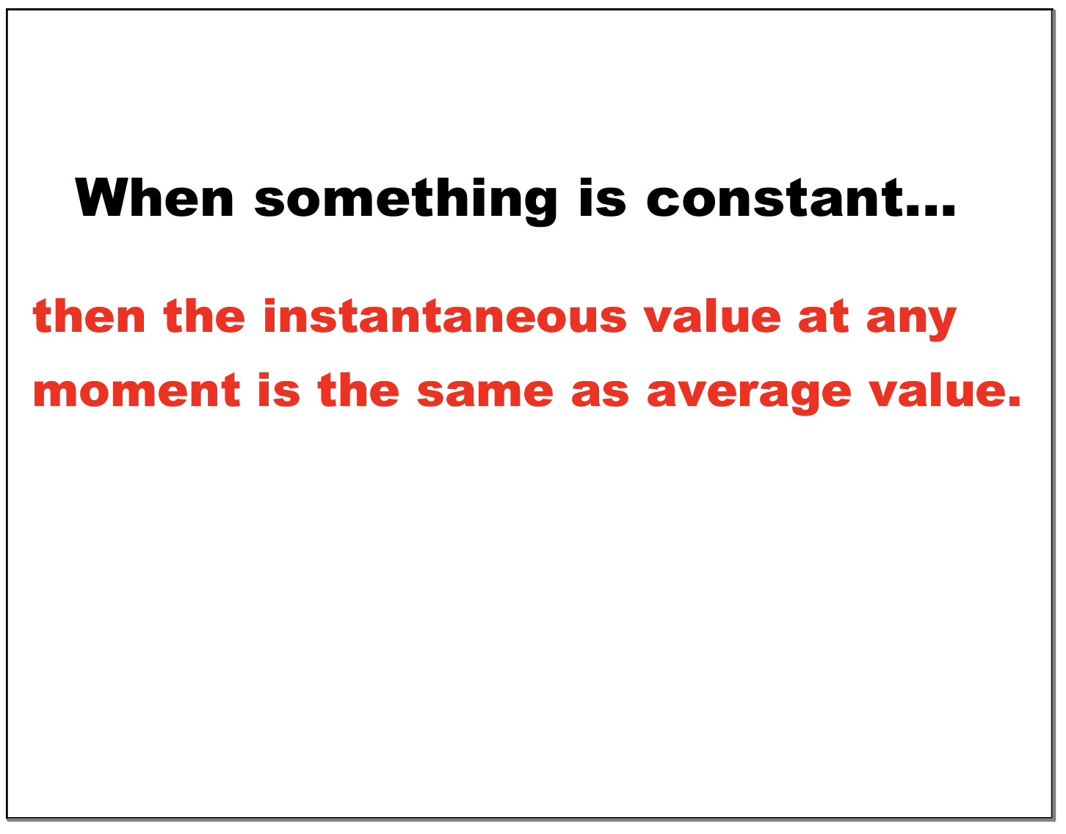

Slide 9
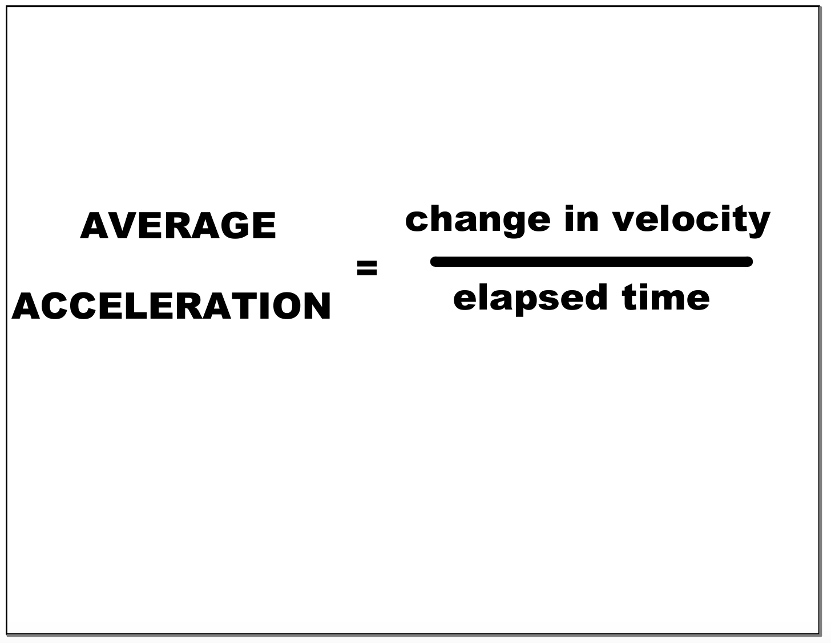

Slide 10
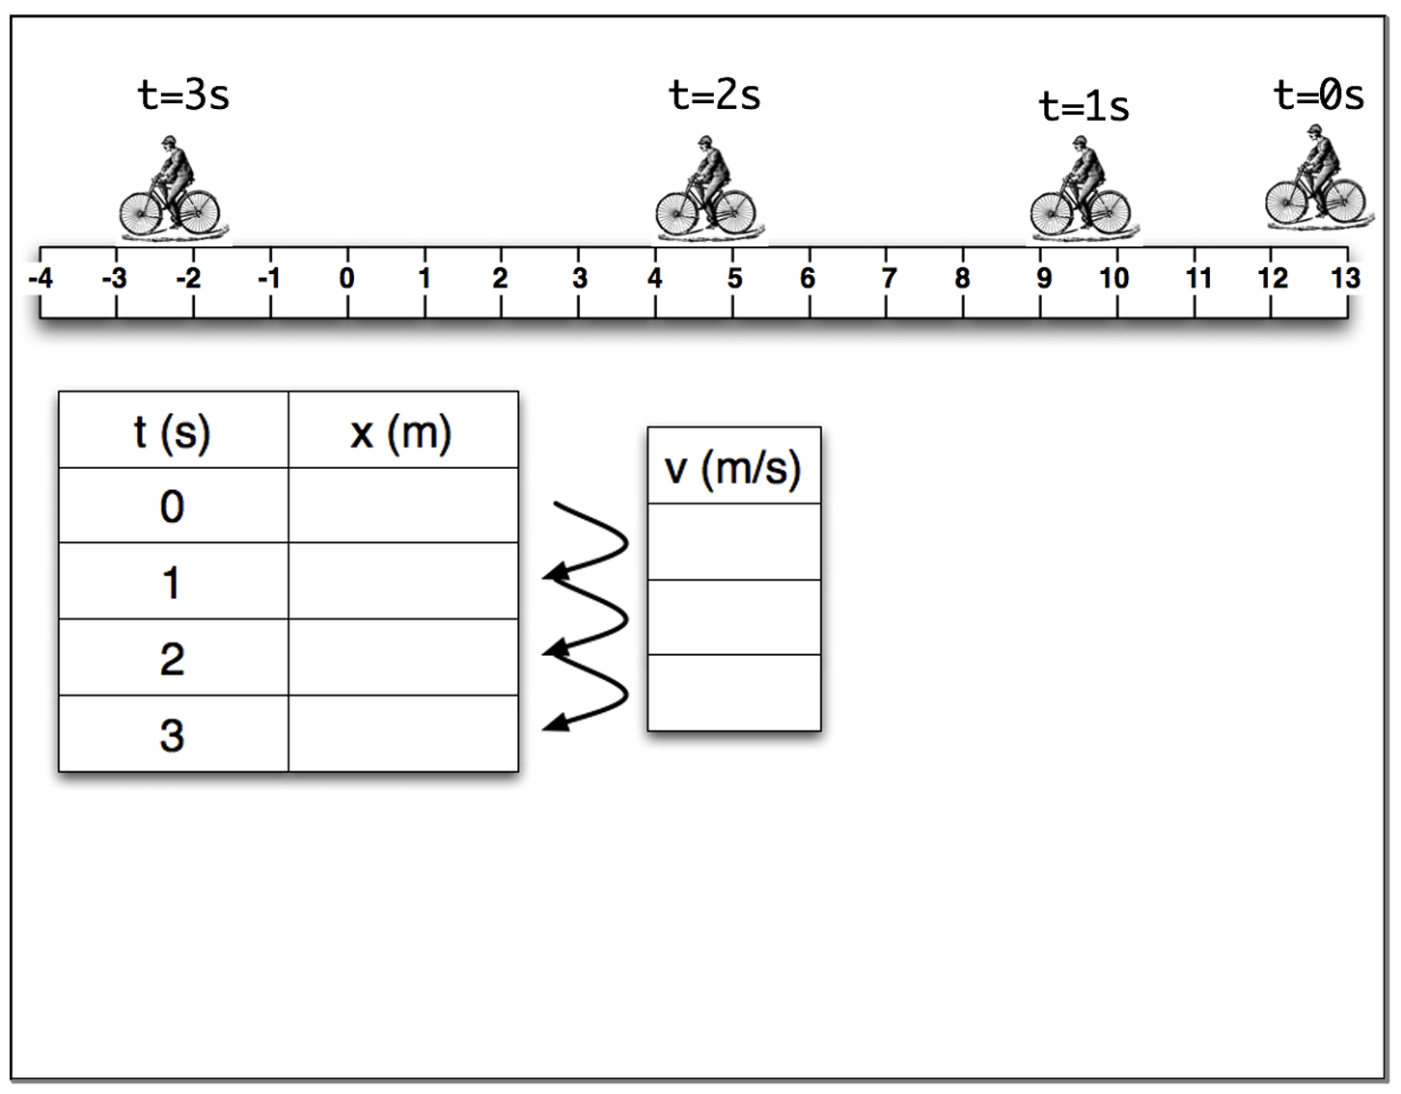

Slide 11
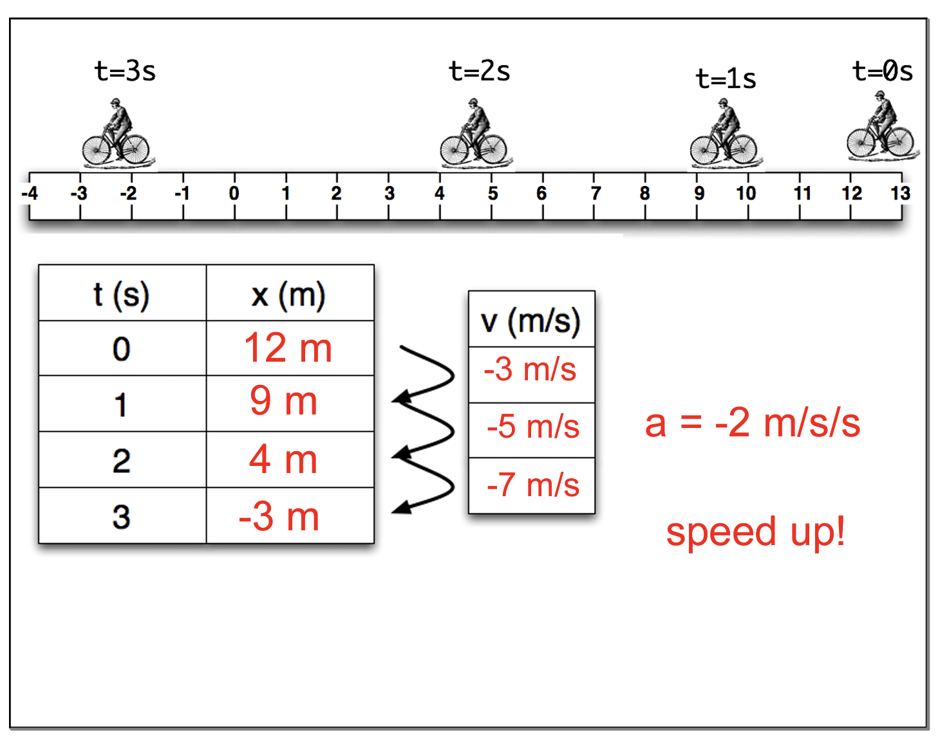

Slide 12
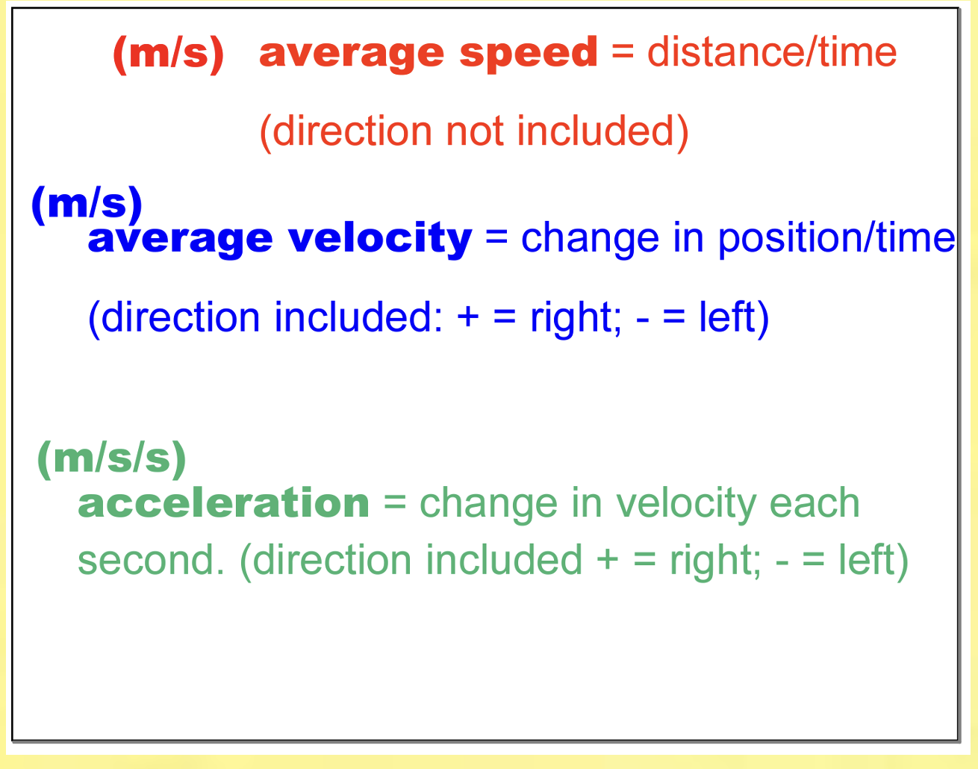

Slide 13
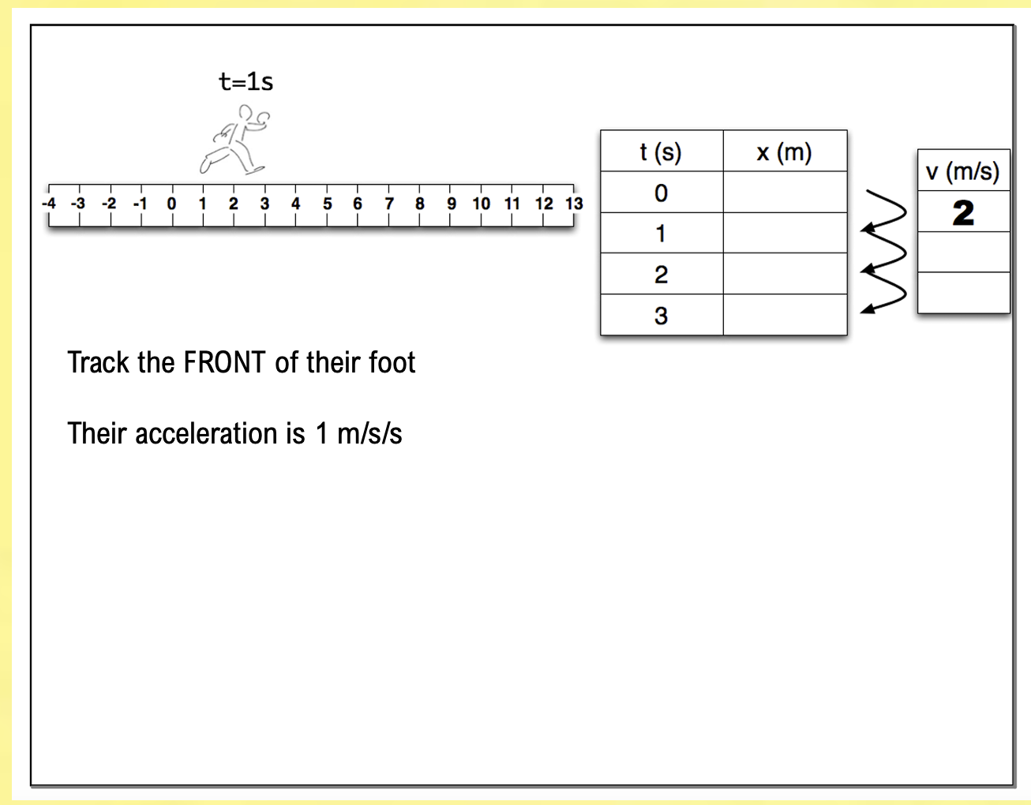

Slide 14
1
3
3
6
4
10

