Slide 1
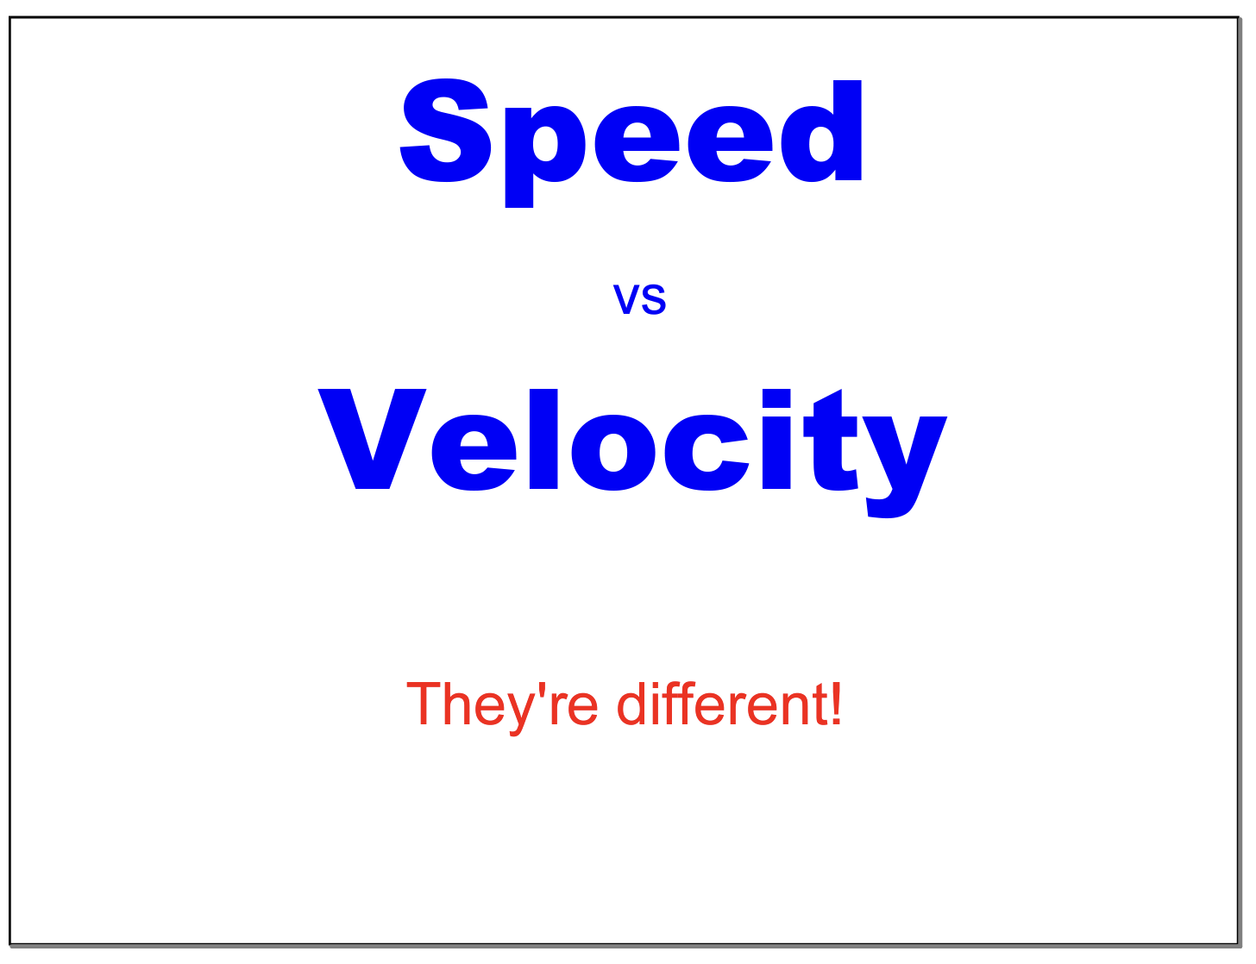

Slide 2
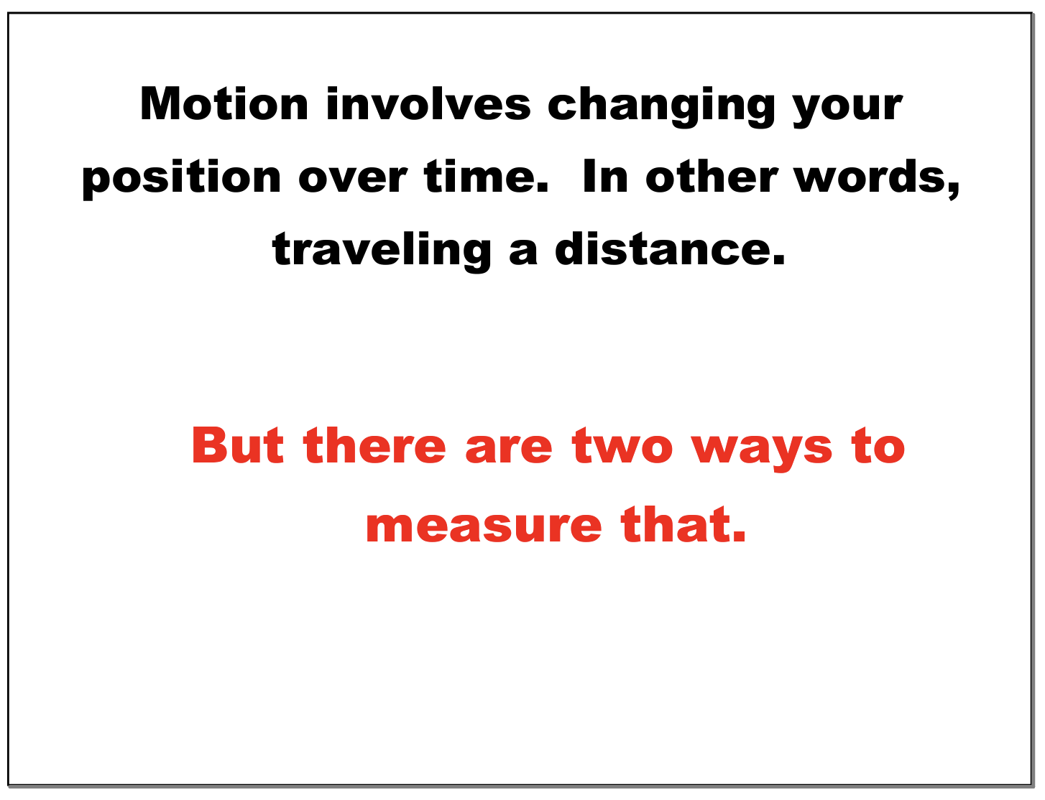

Slide 3
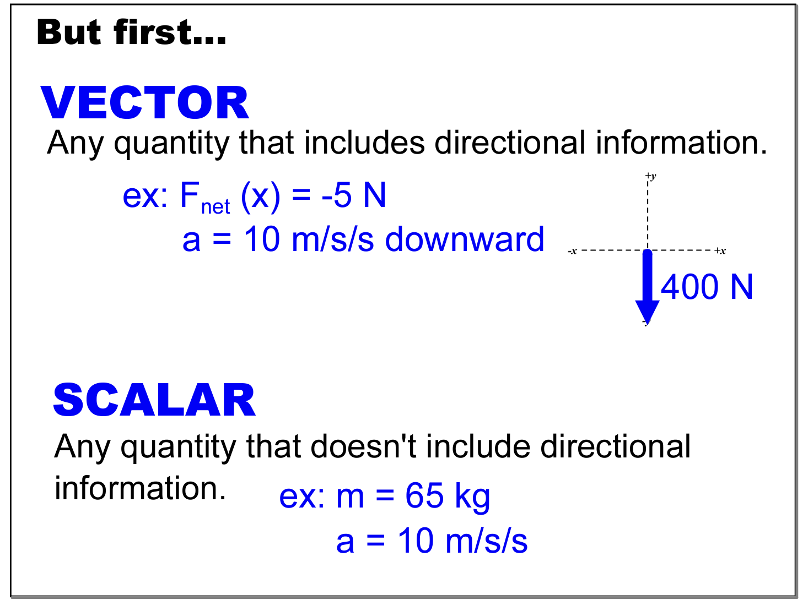

Slide 4
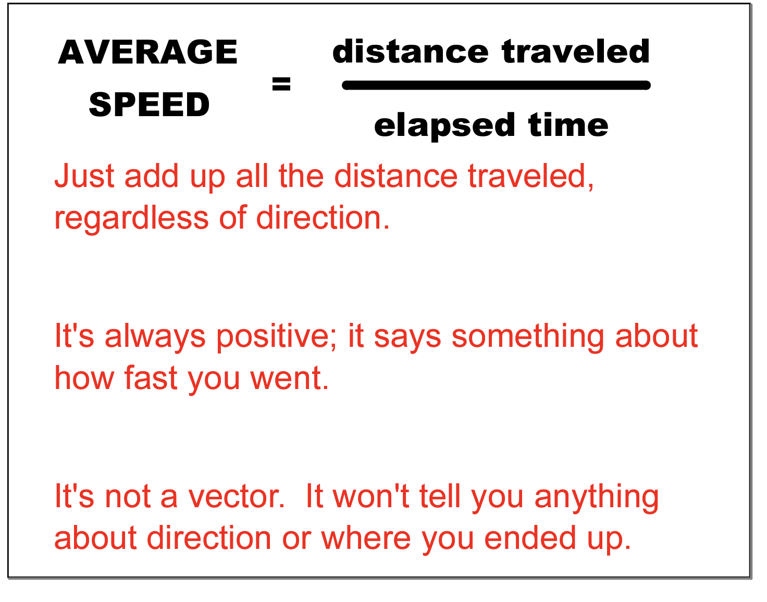

Slide 5
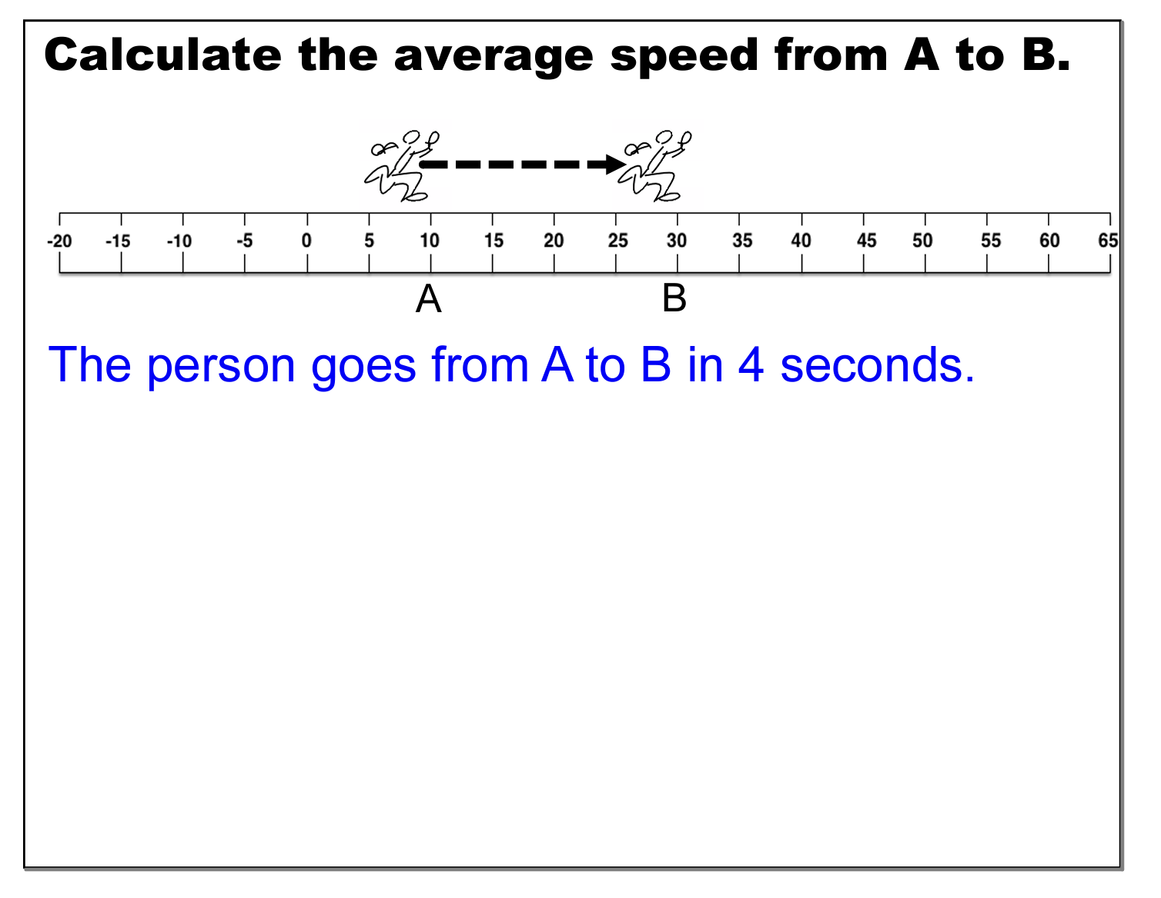
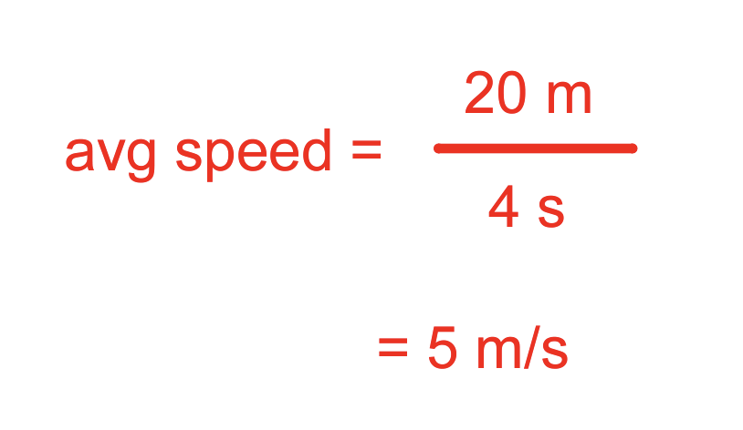

Slide 6
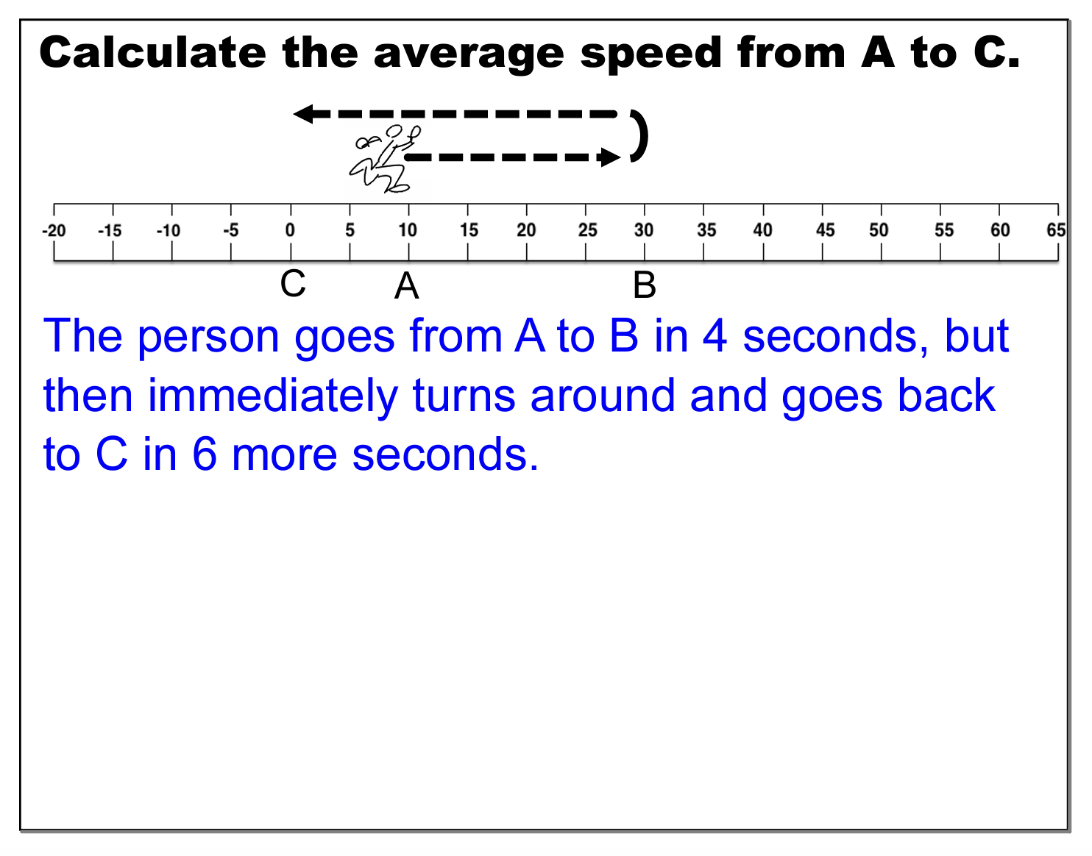
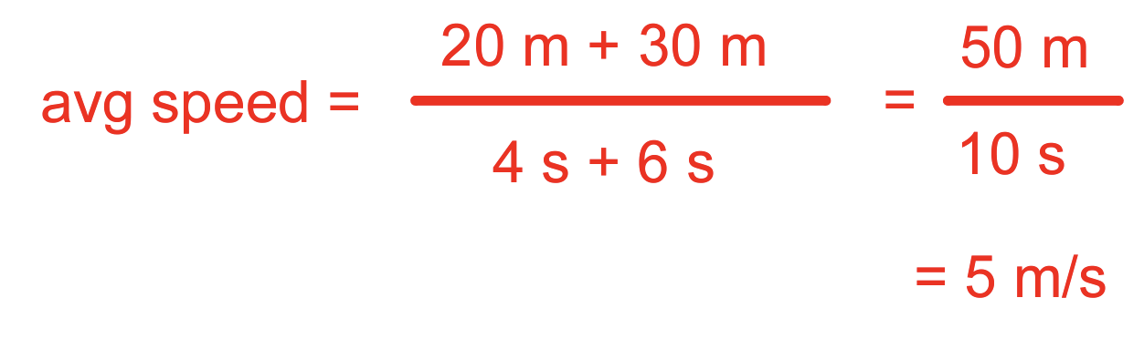

Slide 7
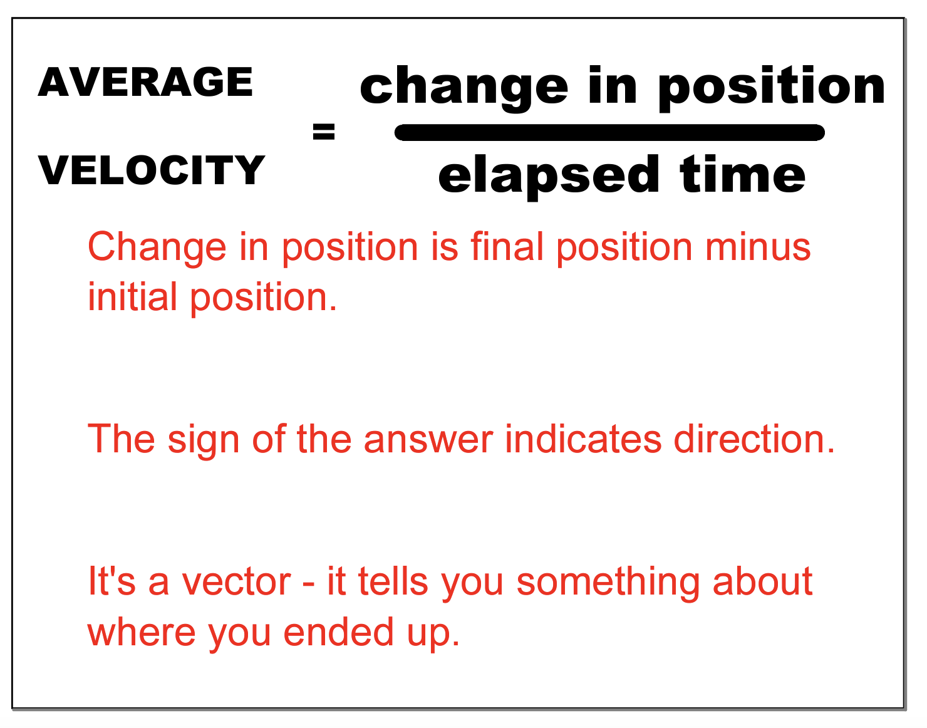

Slide 8
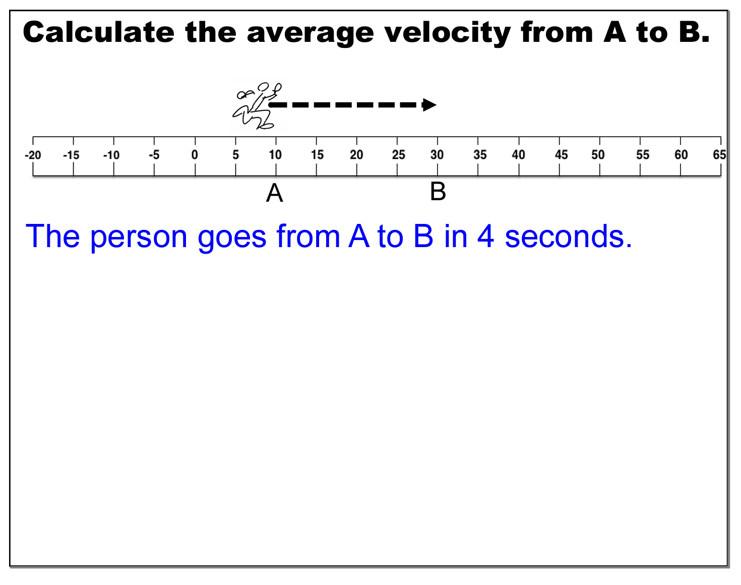
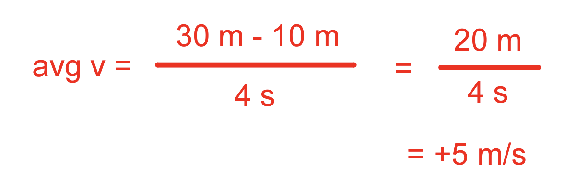

Slide 9
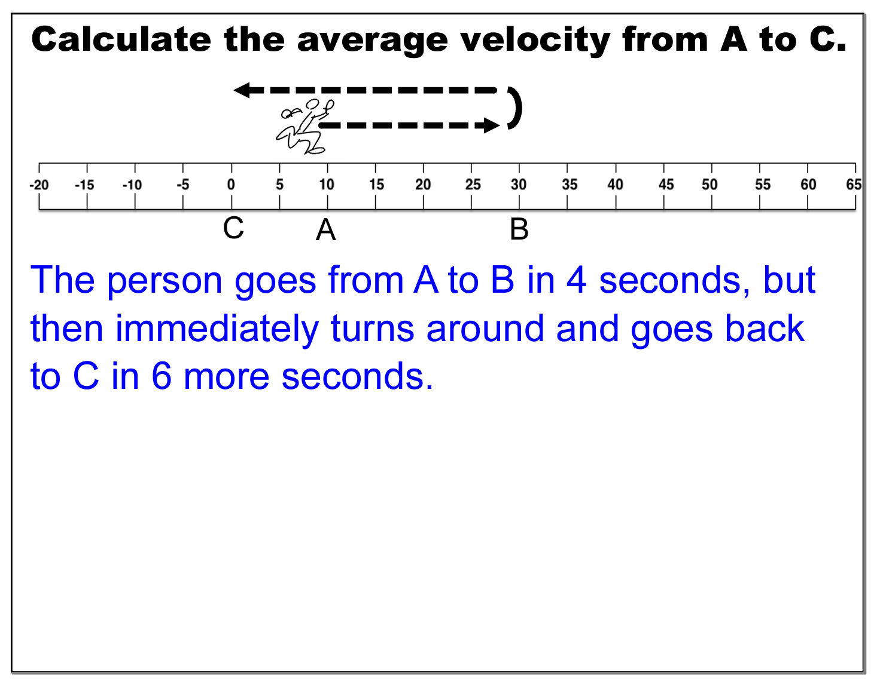

Slide 10
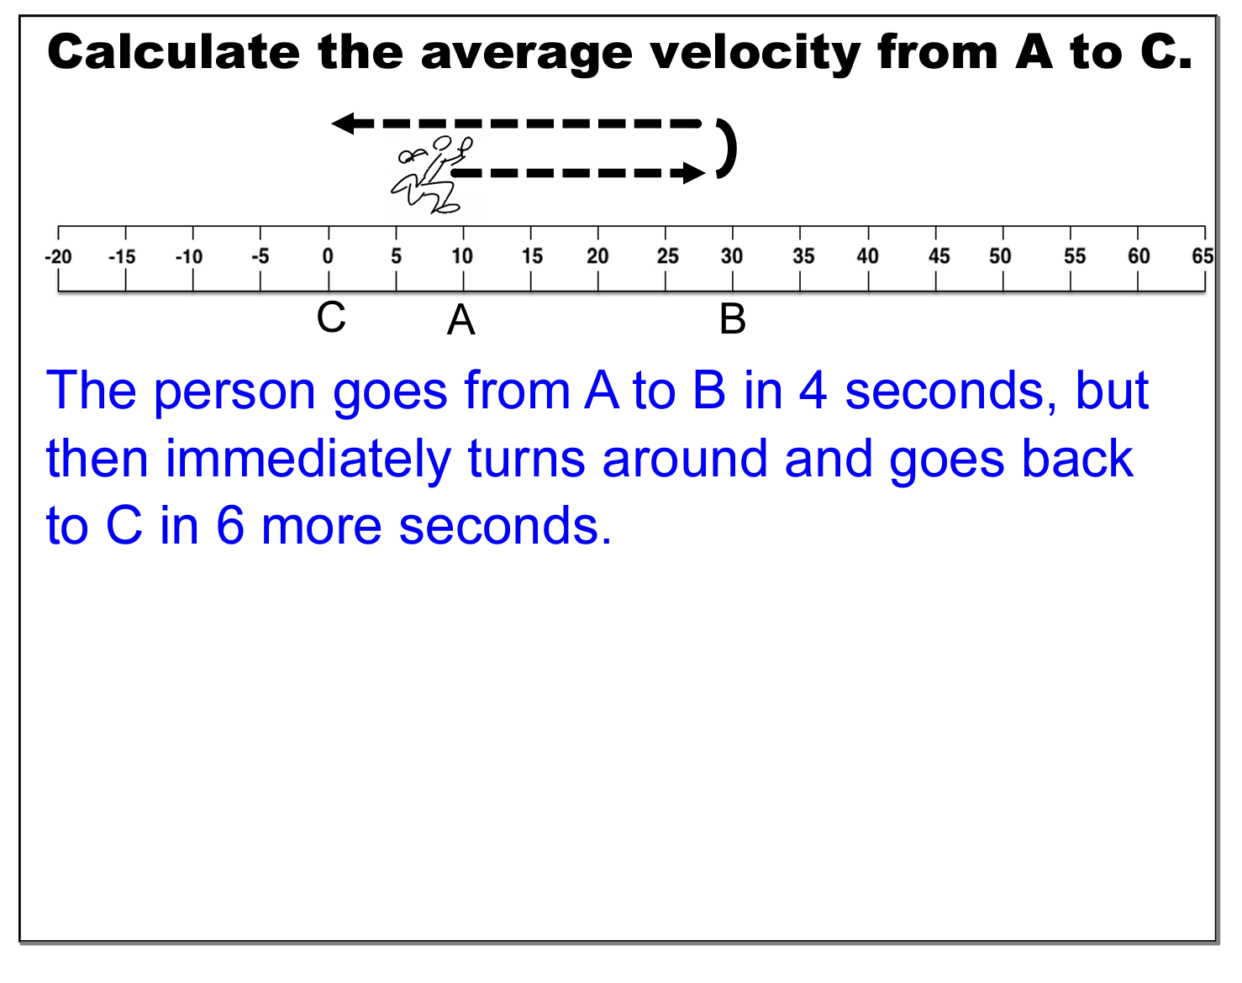
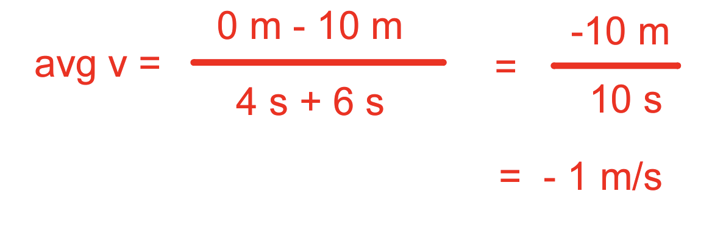
Intermediate positions don’t matter
Final position
Initial position

Slide 11
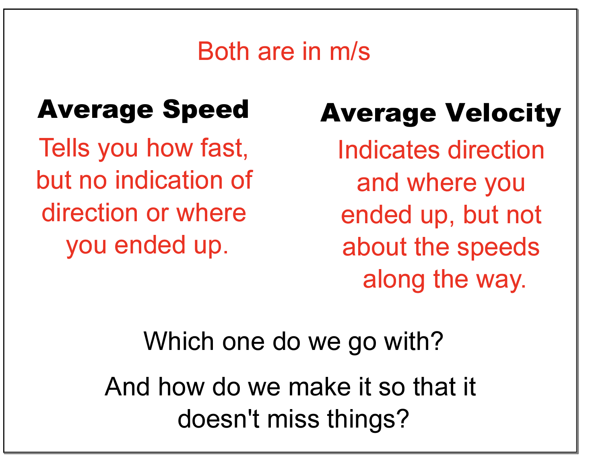

Slide 12
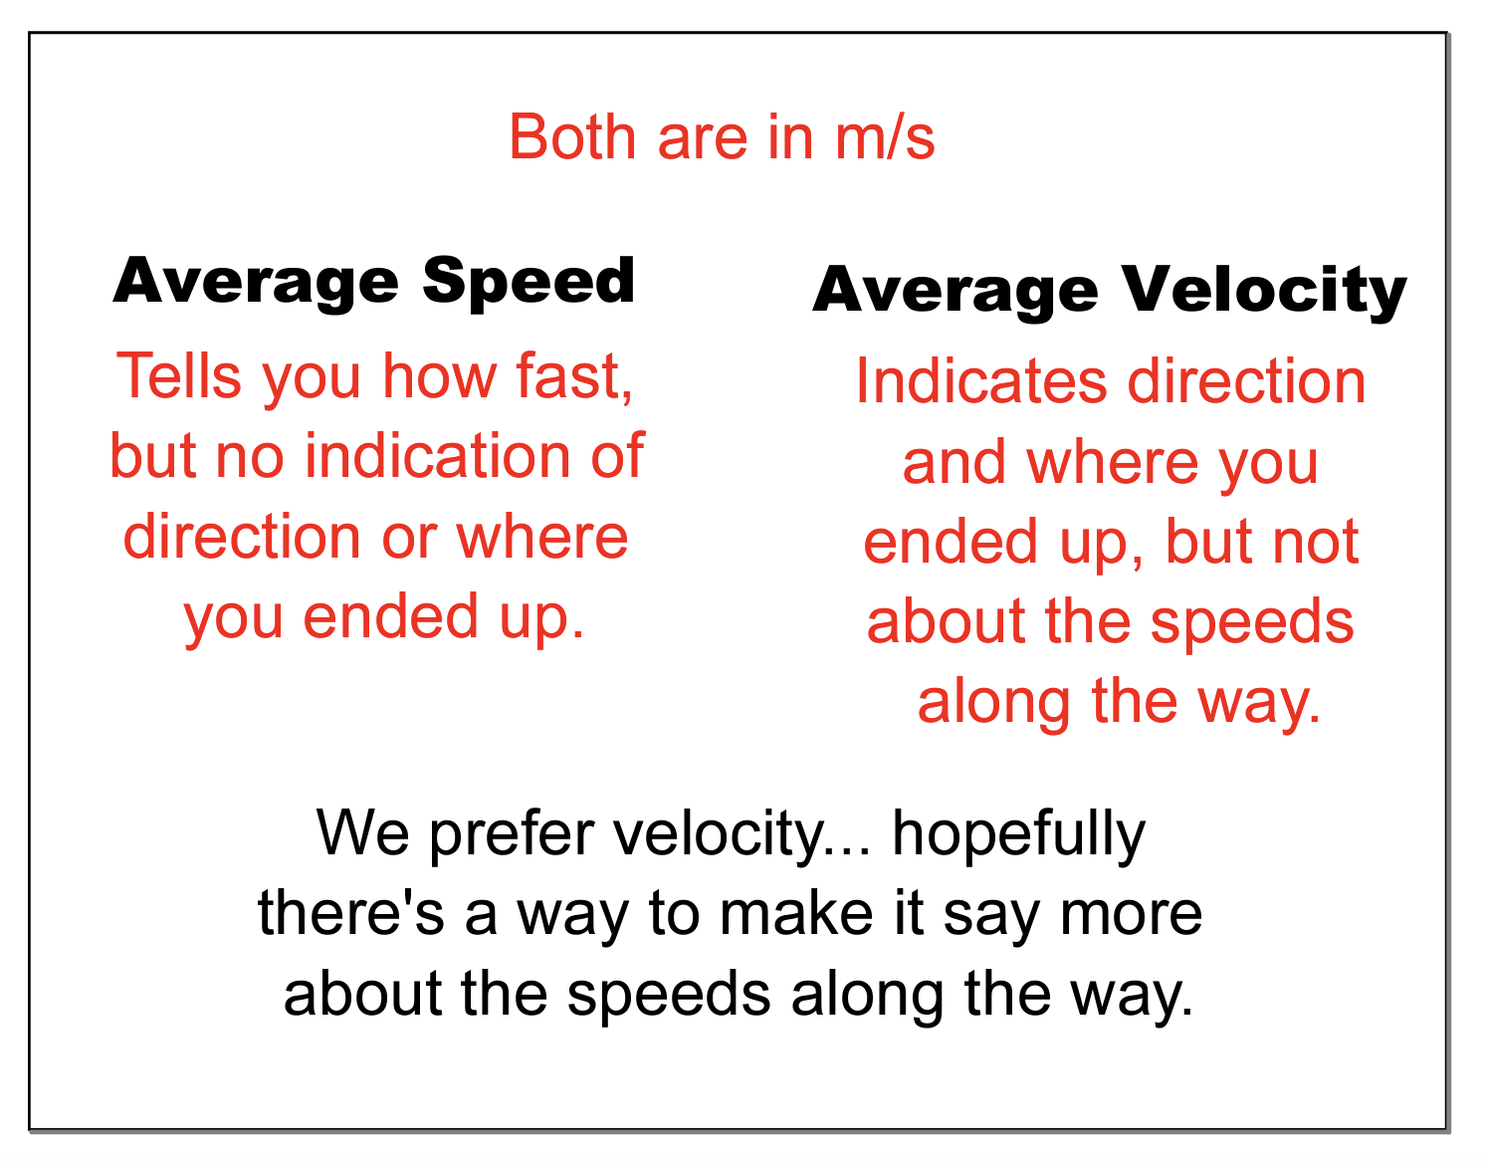

Slide 13
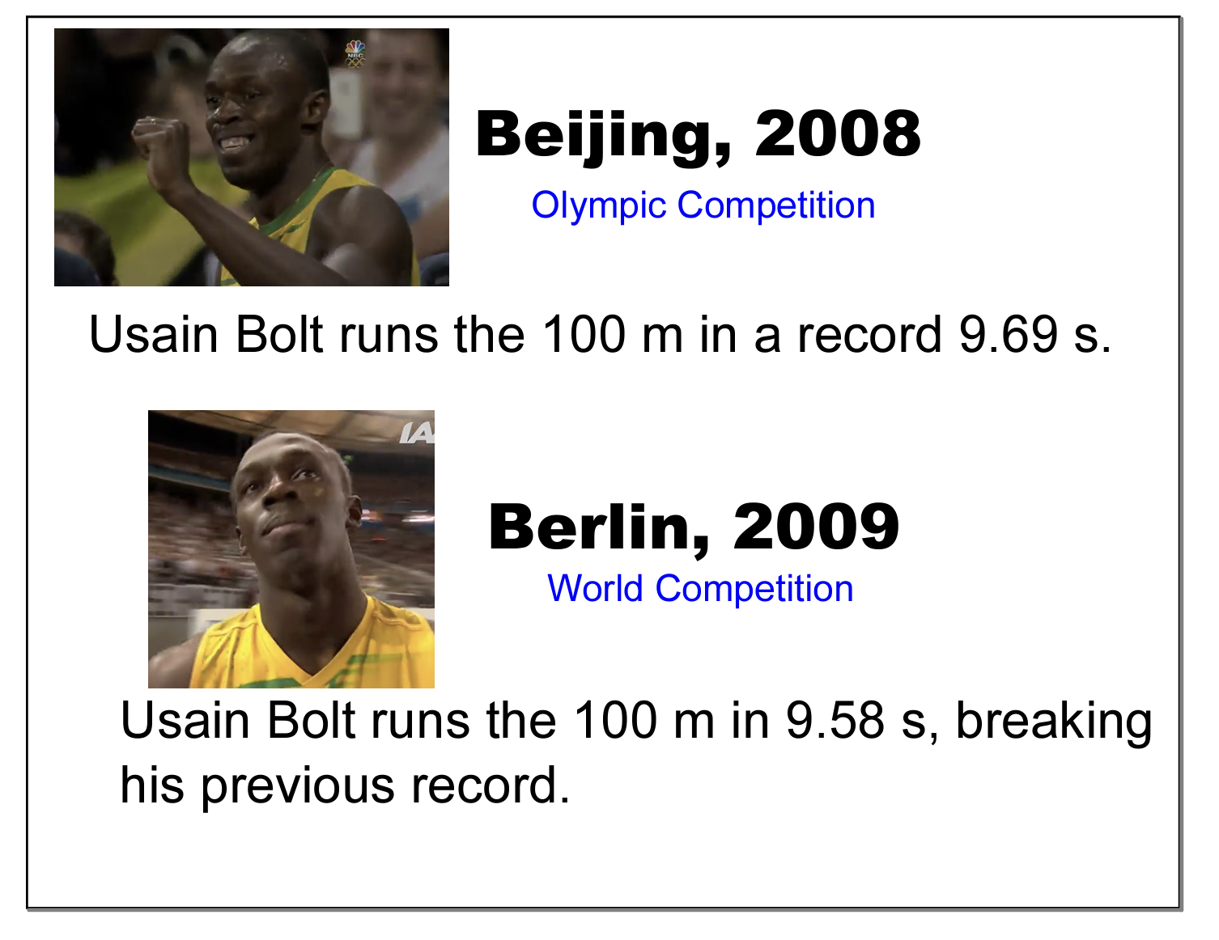
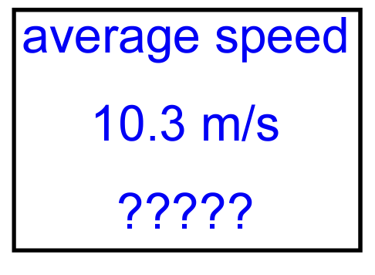
What was Usain Bolt’s Average Speed?

Slide 14
Time (s) | Position (m)
0 | 0
1 | 4
2 | 11
3 | 20
4 | 30
5 | 42
6 | 54
7 | 67
8 | 79
9 | 91
10 | 101
Velocity (m/s)

Slide 15
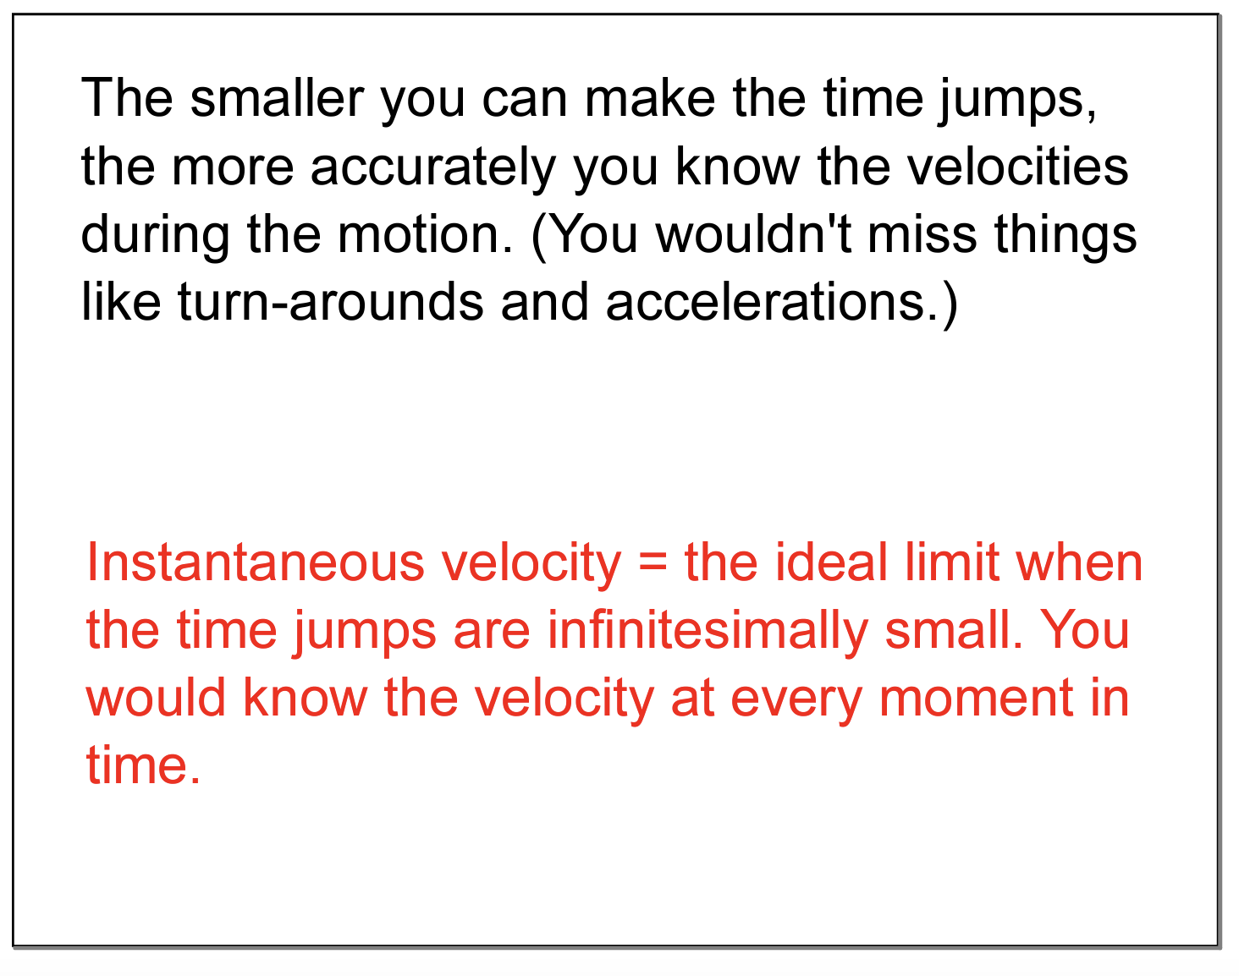

Slide 16
The average speed and the average velocity give you the speed and velocity over the entire journey!
Instantaneous speed and instantaneous velocity give you speed and velocity over an increment of time in the journey!

