Slide 1

My Solar System
Sam Pell

Slide 2
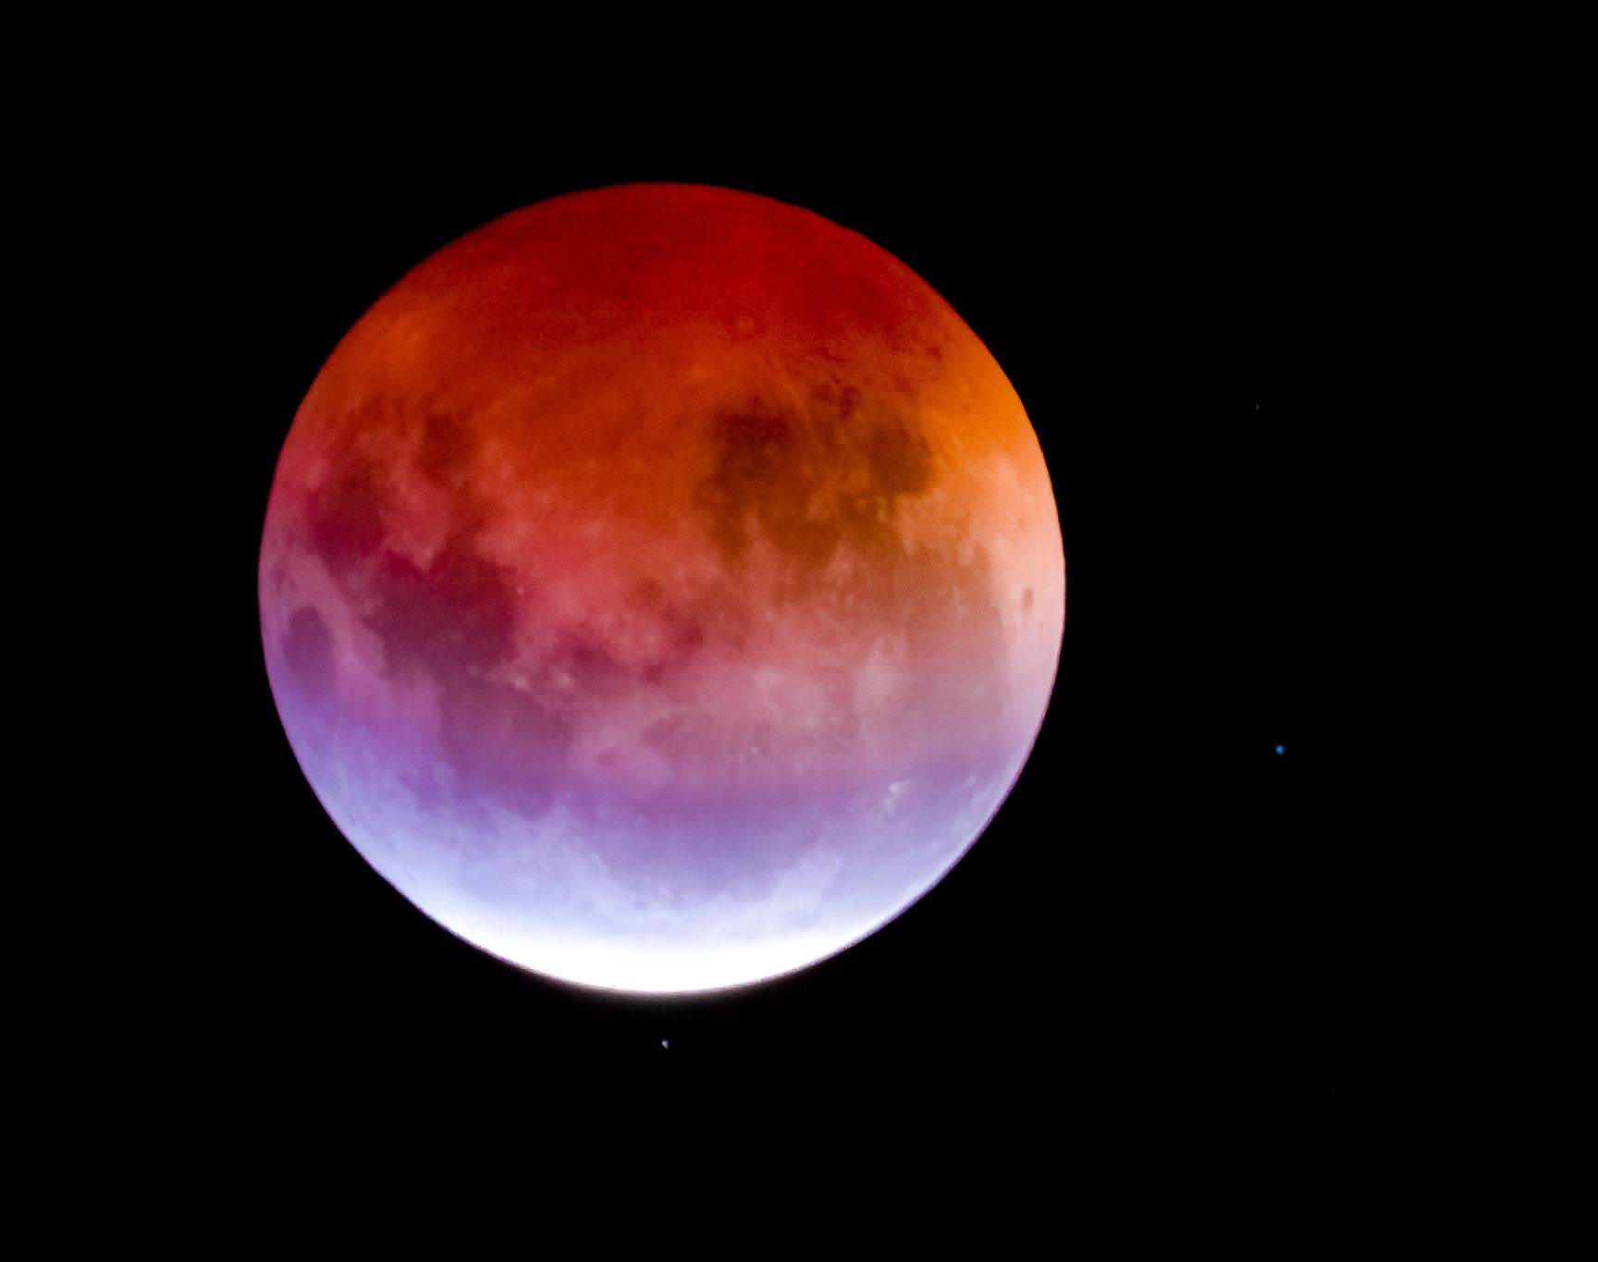
Planet order from CLOSEST to FURTHEST from our Sun
1.) Arrakis
2.) Endor
3.) Gallifrey
4.) Krypton
5.) Miller’s Planet

Slide 3
Parameters that were received
MOST ELLIPTICAL ORBIT
Planet 1
Planet 5
Planet 2
Planet 3
Planet 4
LEAST ELLIPTICAL ORBIT
Orbital Periods
Planet 1 = 3 Earth Years
Planet 2 = 5.5 Earth Years
Planet 3 = 6.5 Earth Years
Planet 4 = 10.3 Earth Years
Planet 5 = 17.1 Earth Years
Star = 15.5 Solar Masses
Therefore, our planets orbits from MOST ELLIPTICAL to LEAST ELLIPTICAL are…
Arrakis
Miller’s Planet
Endor
Gallifrey
Krypton
Therefore, the orbital period for each planet is…
Arrakis = 3 Earth Years
Endor = 5.5 Earth Years
Gallifrey = 6.5 Earth Years
Krypton = 10.3 Earth Years
Miller’s Planet = 17.1 Earth Years

Slide 4
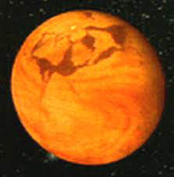

Arrakis

Slide 5
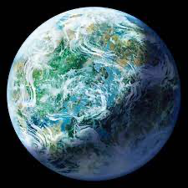

Endor

Slide 6
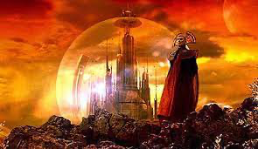

Gallifrey

Slide 7


Krypton

Slide 8


Miller’s Planet

Slide 9
Summary:
Most to Least Elliptical
Arrakis: 0.308
Miller’s Planet: 0.285
Endor: 0.167
Gallifrey: 0.103
Krypton: 0.042
Distance: From Closest to Furthest
Arrakis: 5.2 AU
Endor: 7.8 AU
Gallifrey: 8.7 AU
Krypton: 11.8 AU
Miller’s Planet: 16.5 AU

